Slide 1
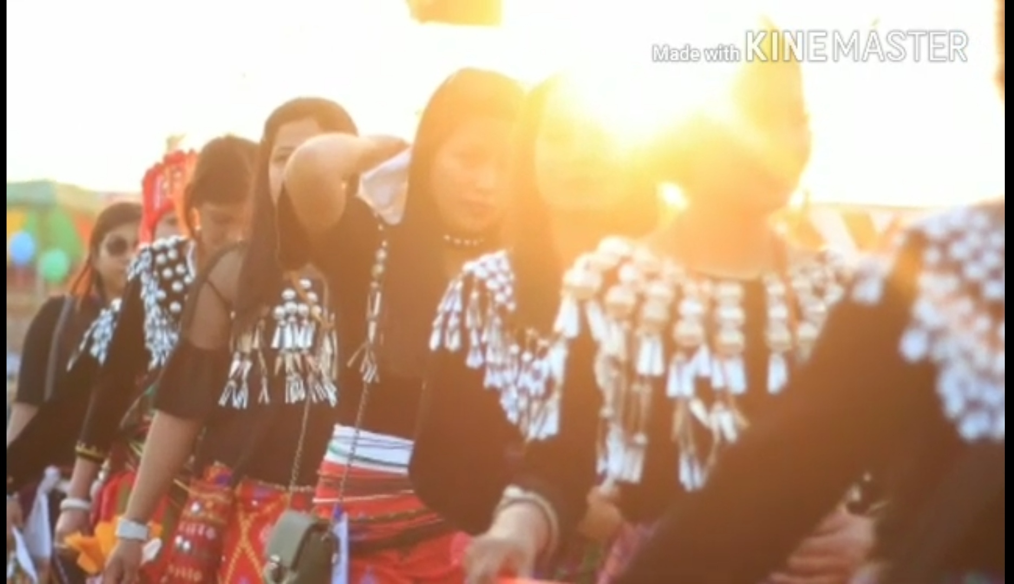
MARVELLOUS
FESTIVALS
A R U N A C H A L P R A D E S H
K I M E C H A D A
2nd YEAR MECHANICAL ENGINEERING
NATIONAL INSTITUTE OF TECHNOLOGY
ARUNACHAL PRADESH

Slide 2
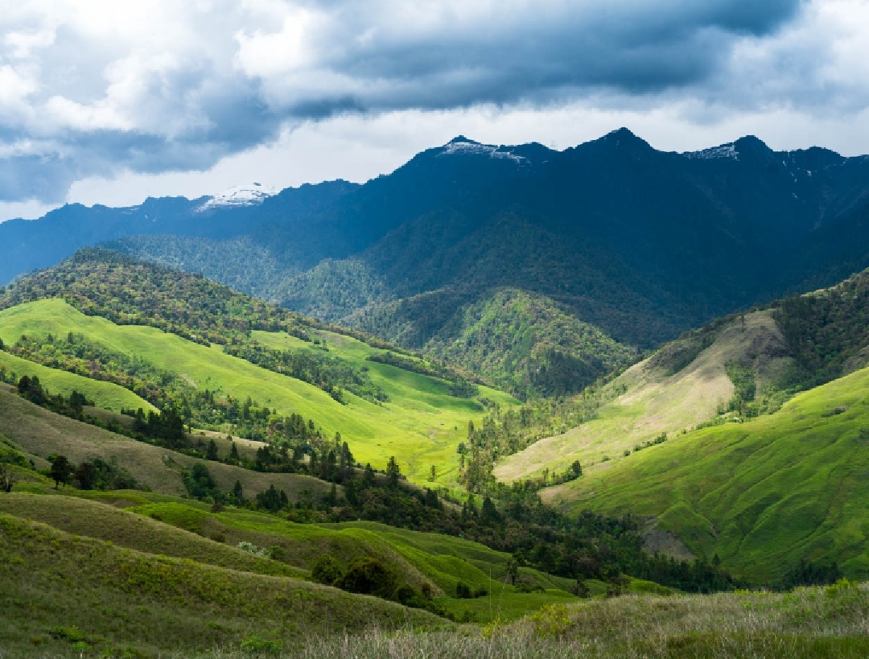
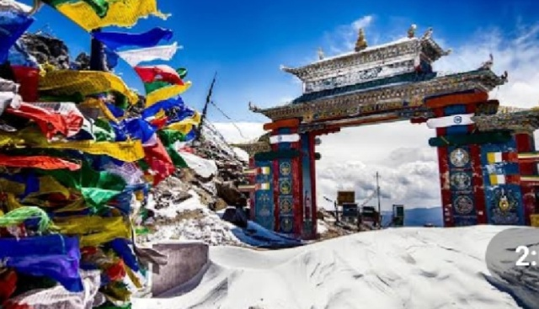
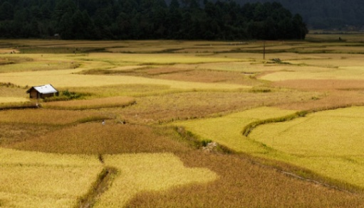
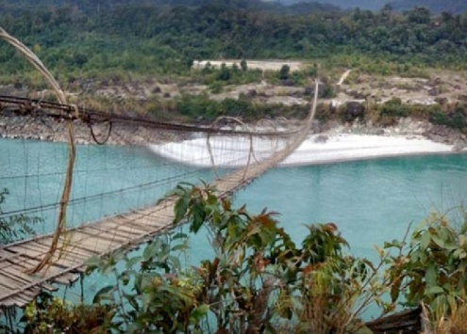
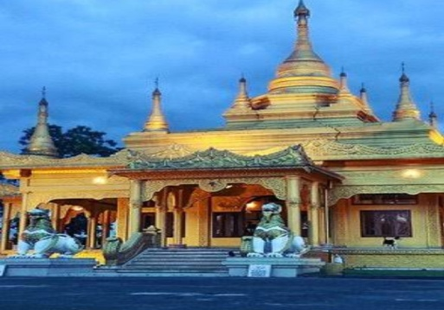
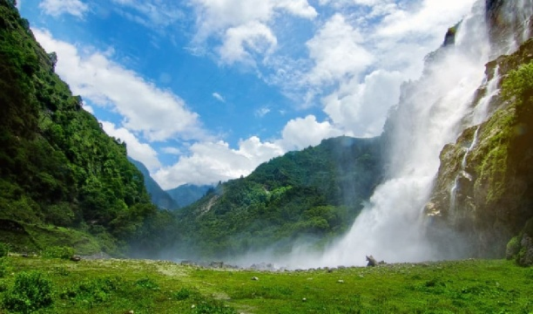
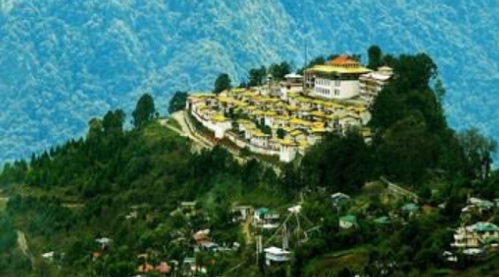
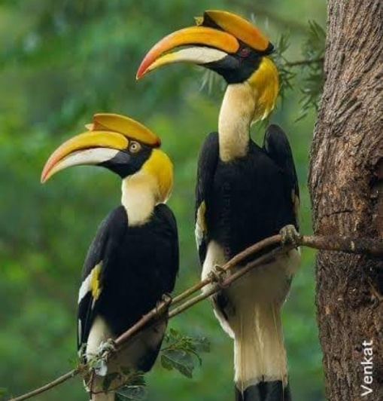
Arunachal Pradesh is a wonderful
place any day
Festivals are essential part of socio cultural
life
Festivals are mostly connected with agriculture , nature worshipping.
Animal sacrifice is a common ritual in most festivals
There is no idol worship in Arunachal
Pradesh culture
Most festivals are celebrated for a week or even month

Slide 3
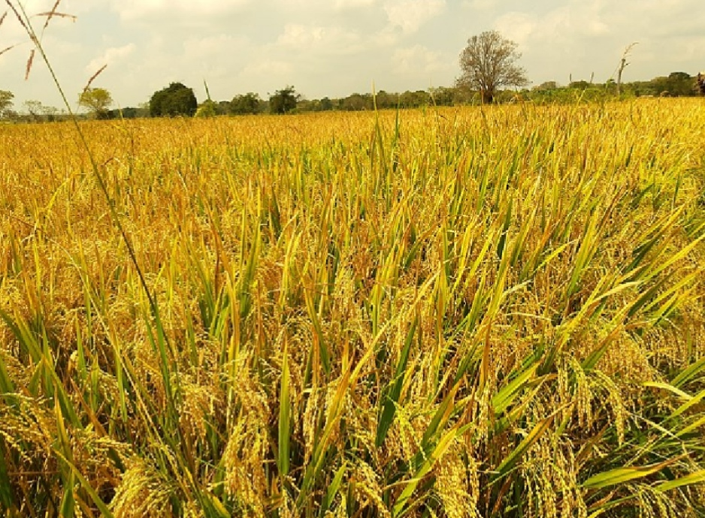
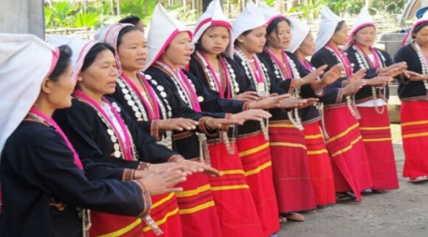
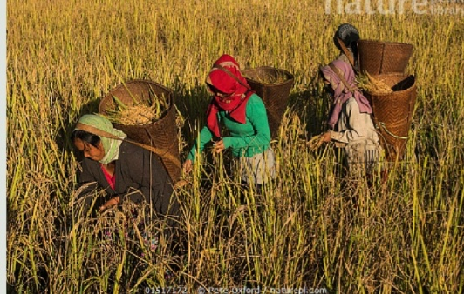
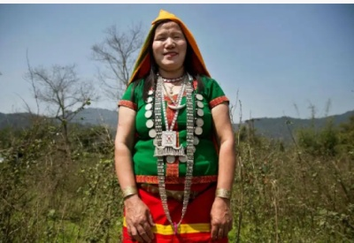
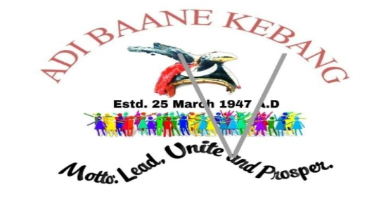
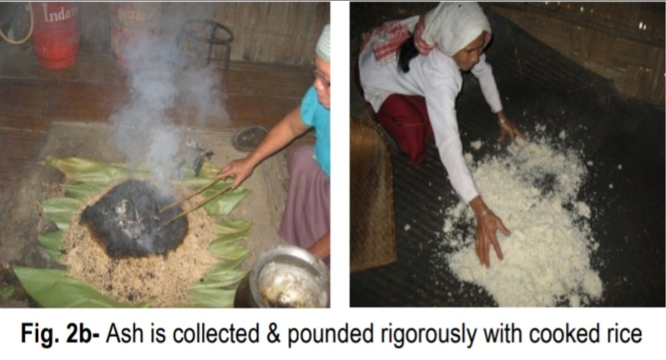
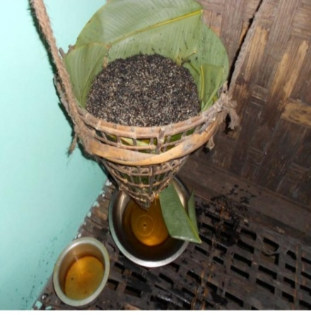
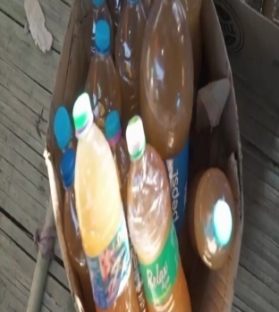
S o l u n g
Solung celebration
Adi women working in
agriculture field
Adi women
Kebang(village council)
Adi women preparing rice beer/APONG
Filtering process to collect the apong
APONG
(Rice beer)

Slide 4
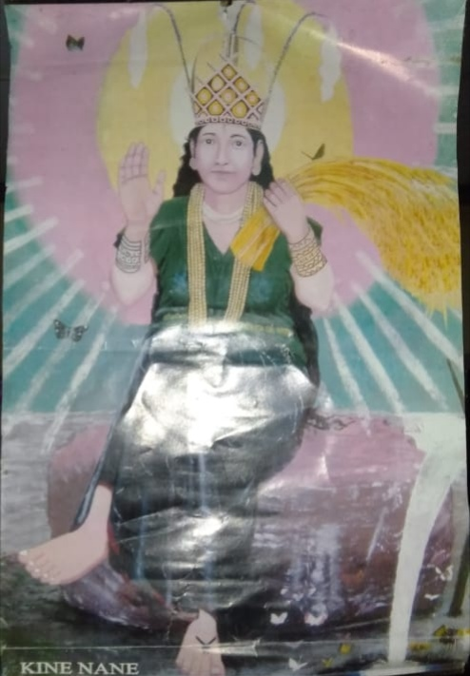
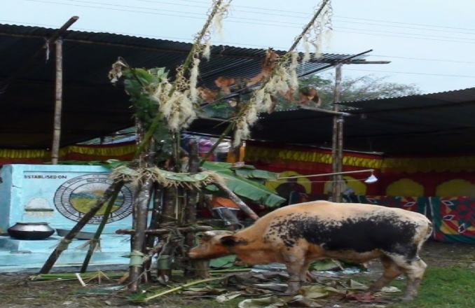
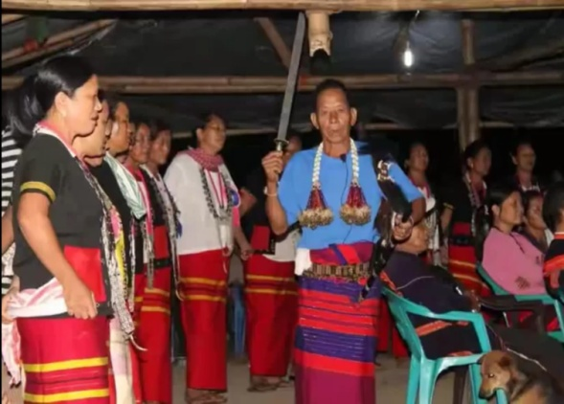
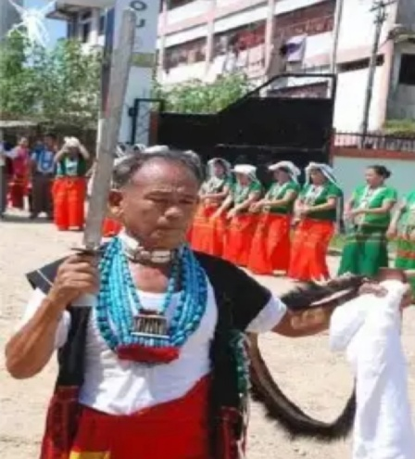
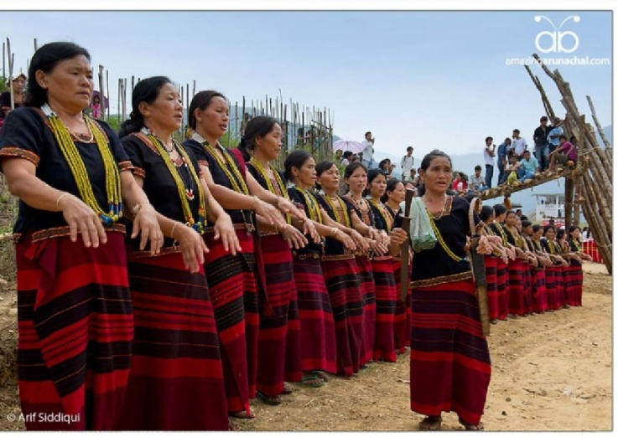
MITHUN
(great Indian bison)
Sacrifice ceremony
Goddess KINE NANE
MIRI performing
SOLUNG ABUNG
MIRI,
Religious leader
or
priest
SOLUNG PONUNG
(Traditional dance)

Slide 5
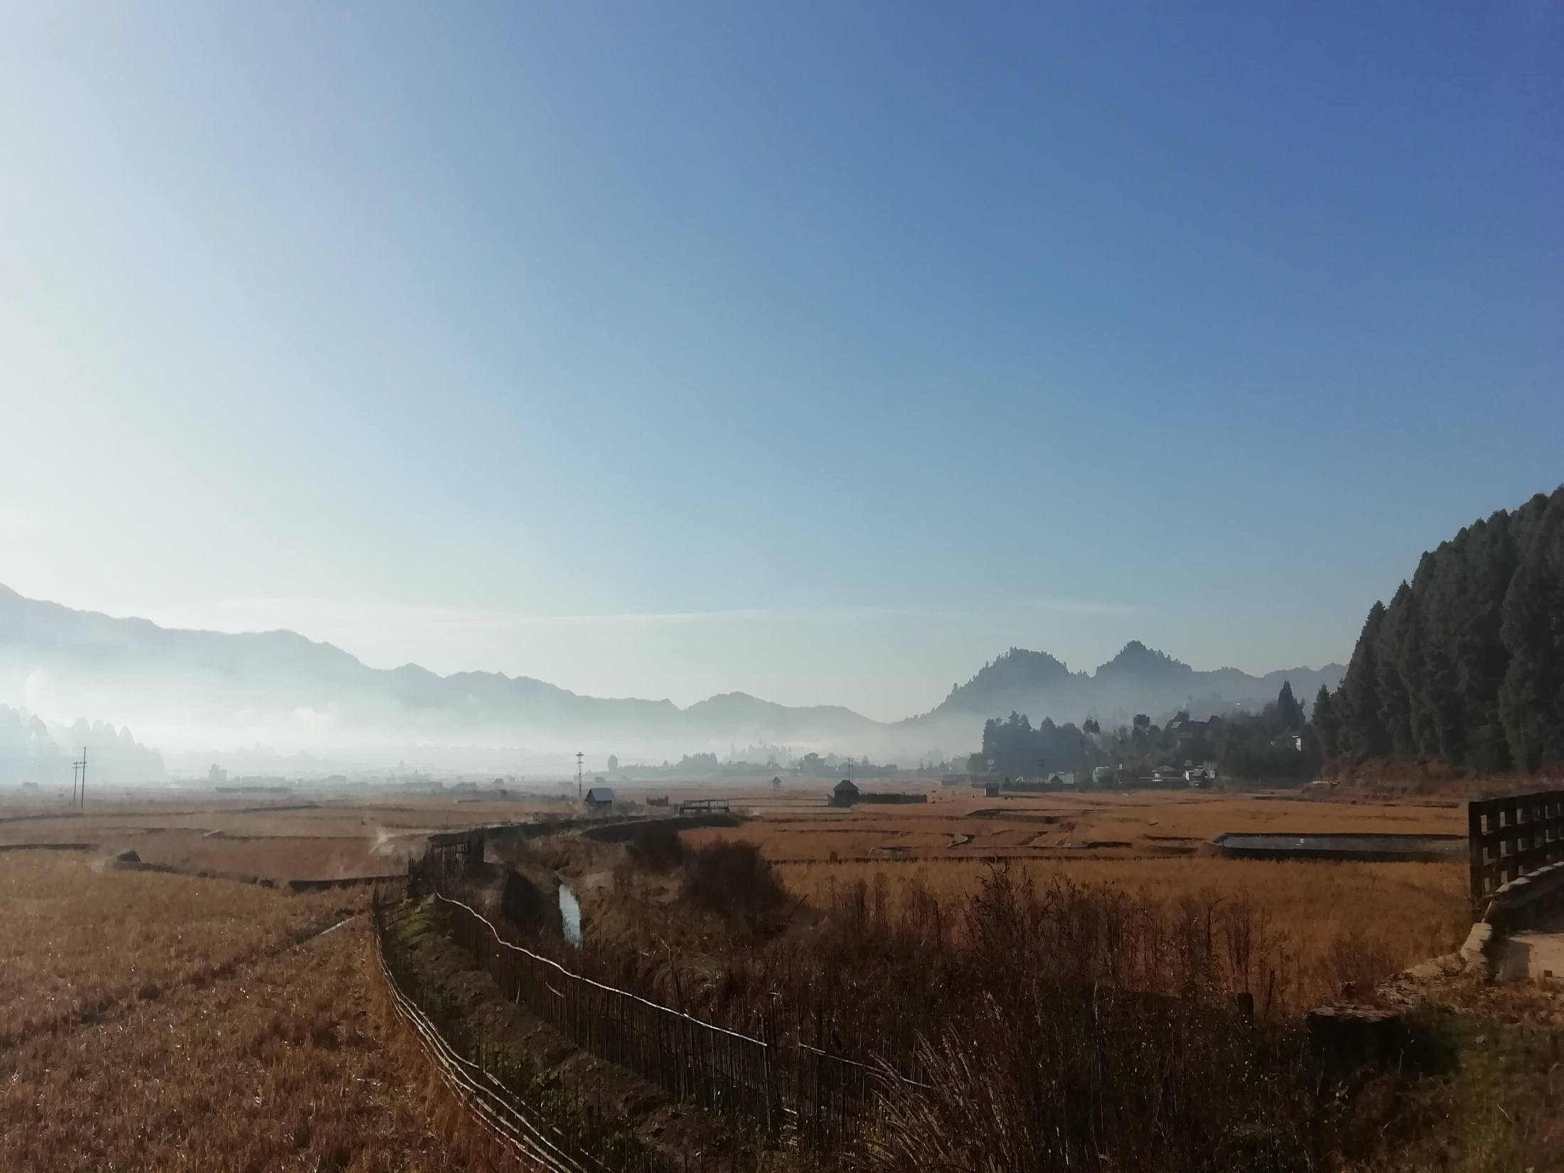
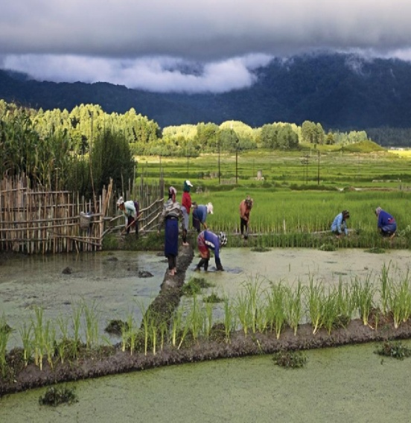
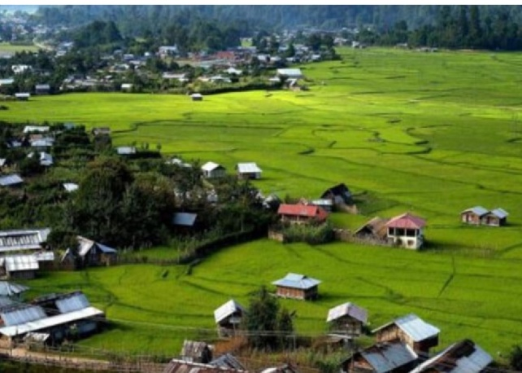
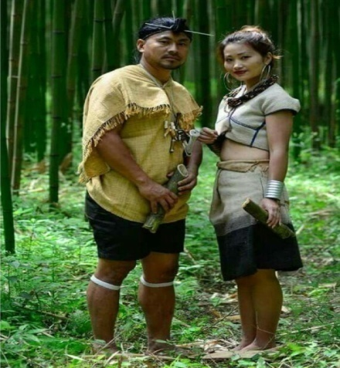
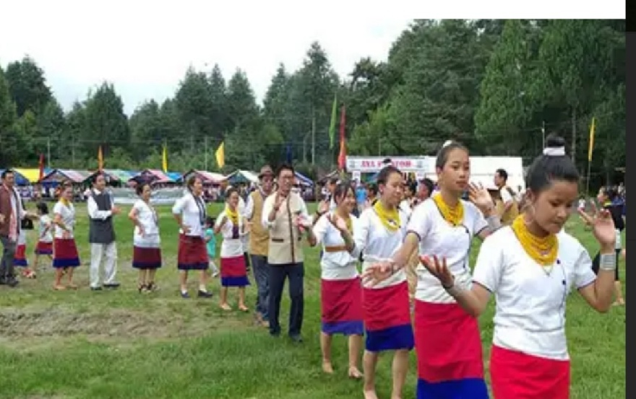
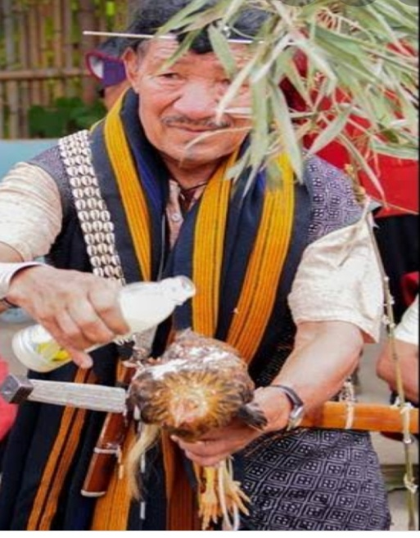
D r e e
ZIRO valley
Apatani wet rice
cultivation
Apatani
Men & women
Local priest
Performing
Sacrificial ritual
Dree festival celebration

Slide 6
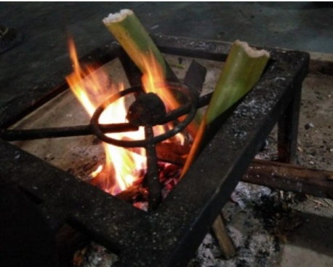
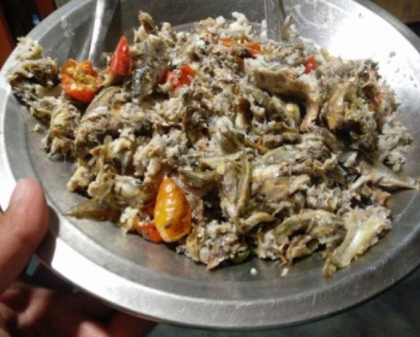
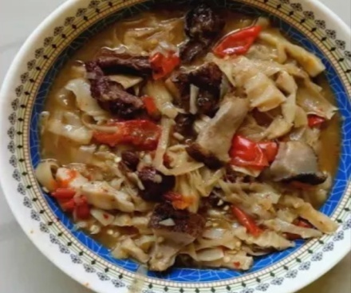
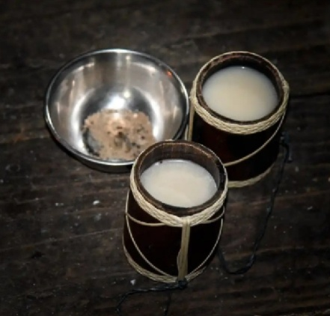
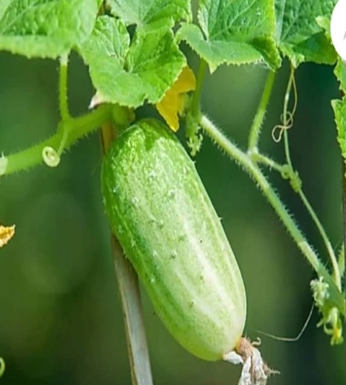
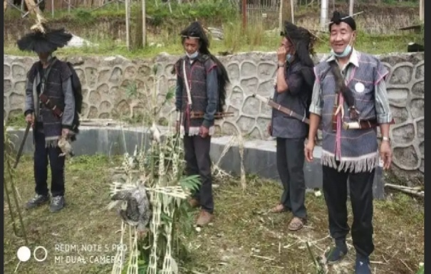
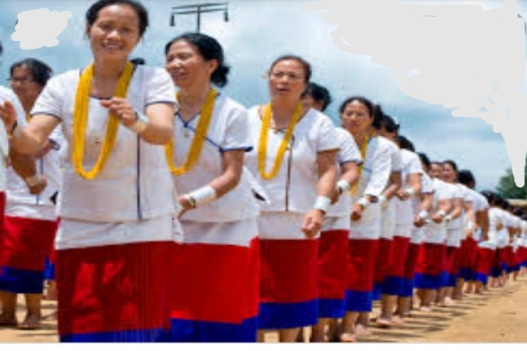
Apatani cuisines
2- Pike pilla
1- Fish cooked in bamboo tube
Dree takun
(cucumber)
Dree ‘o’,apong
(rice beer)
Local priest performing Dree
Festival ritual
Daminda
dance

Slide 7
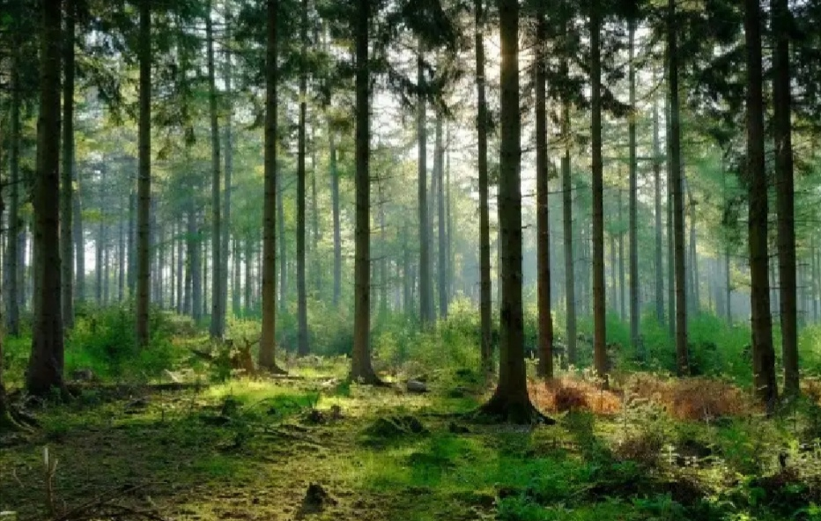
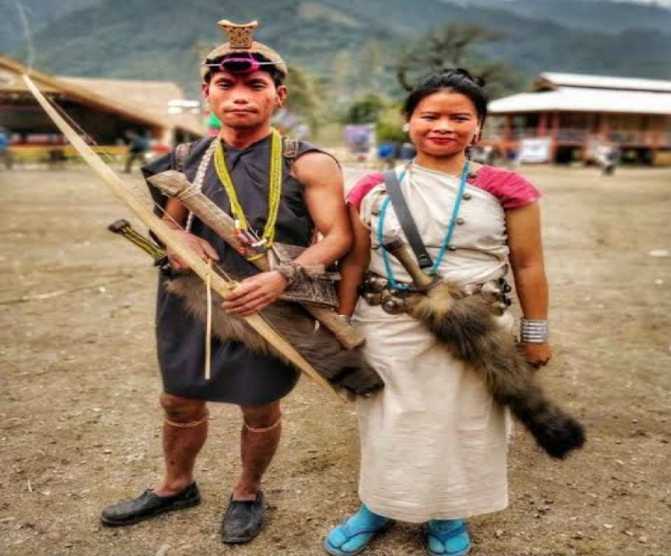
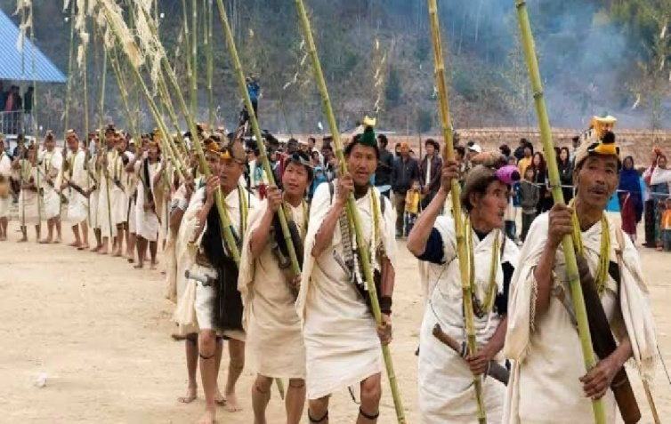
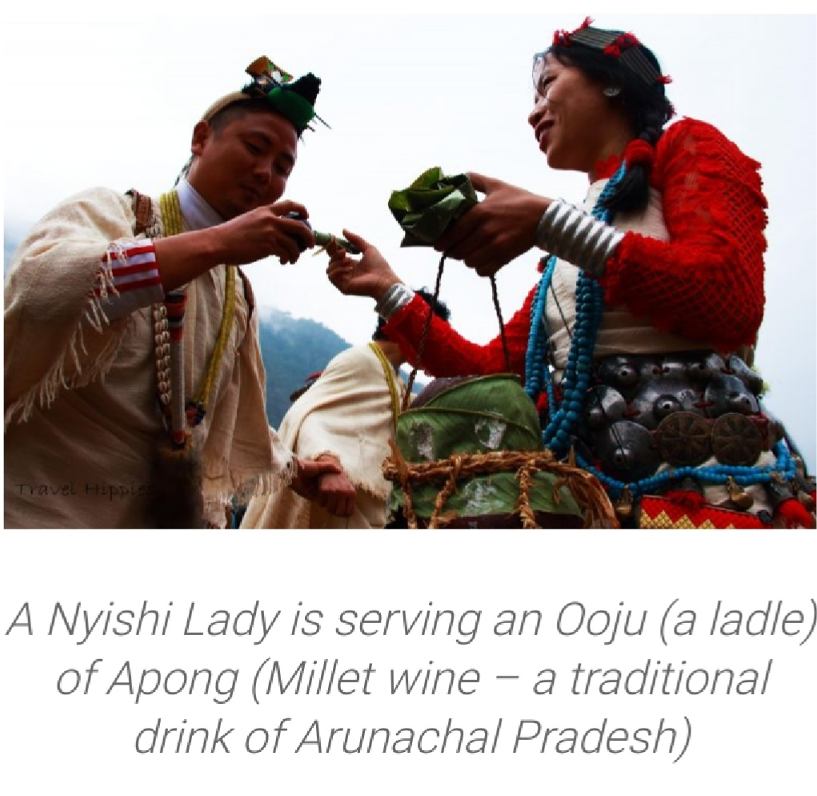
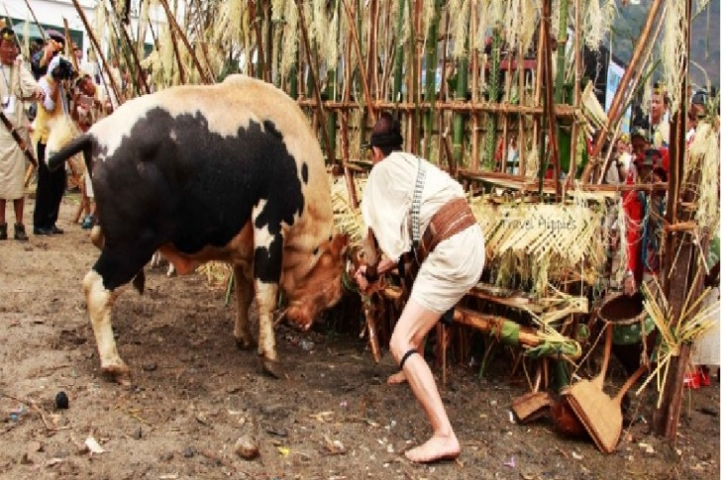
N y o k u m
Nyokum celebration
Nyishi men & women
Welcoming
Of guest with
Millet beer
& rice paste
powder
Animal sacrifice

Slide 8
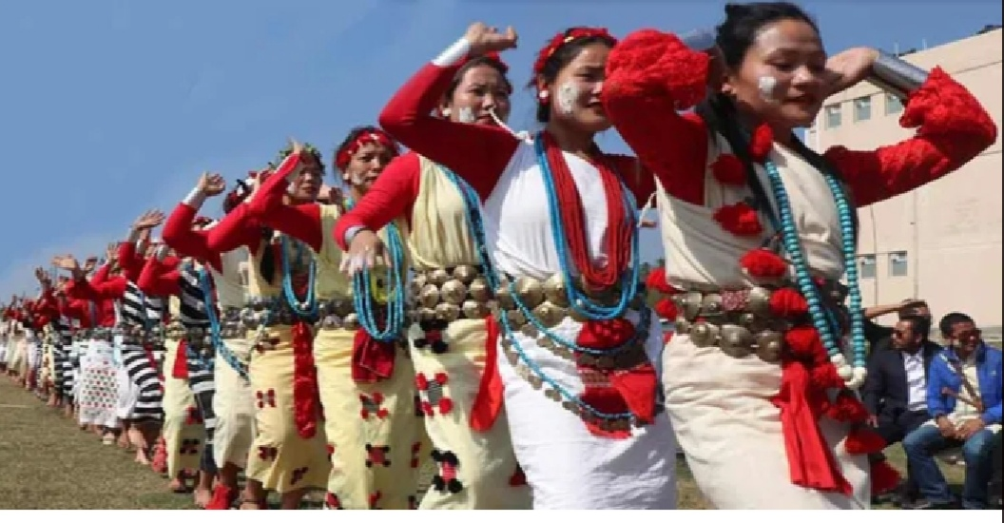
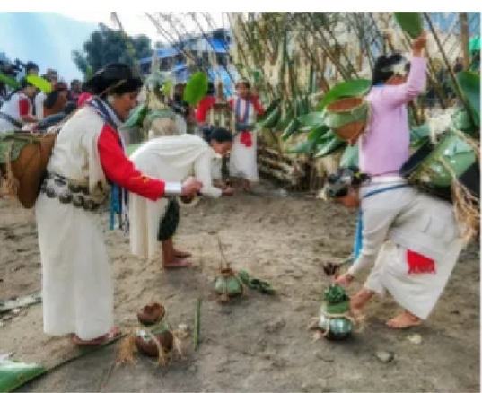
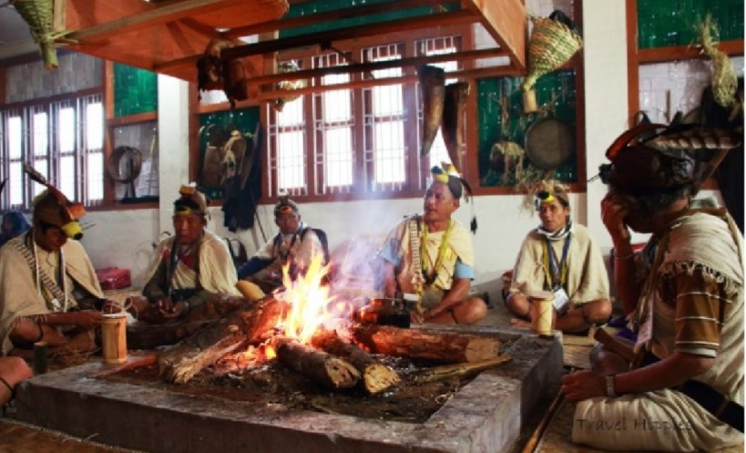
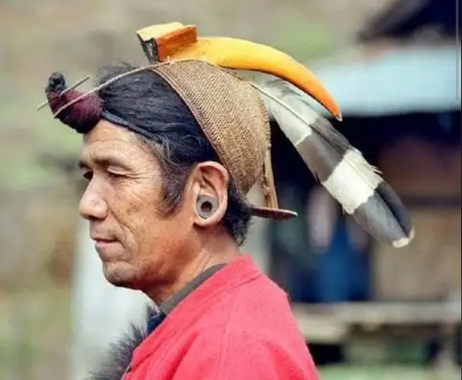
Women performing
Rituals
Nyokum dance prior to
Nyokum rituals
Local priest performing
Rituals
Traditional Nyishi cap

Slide 9
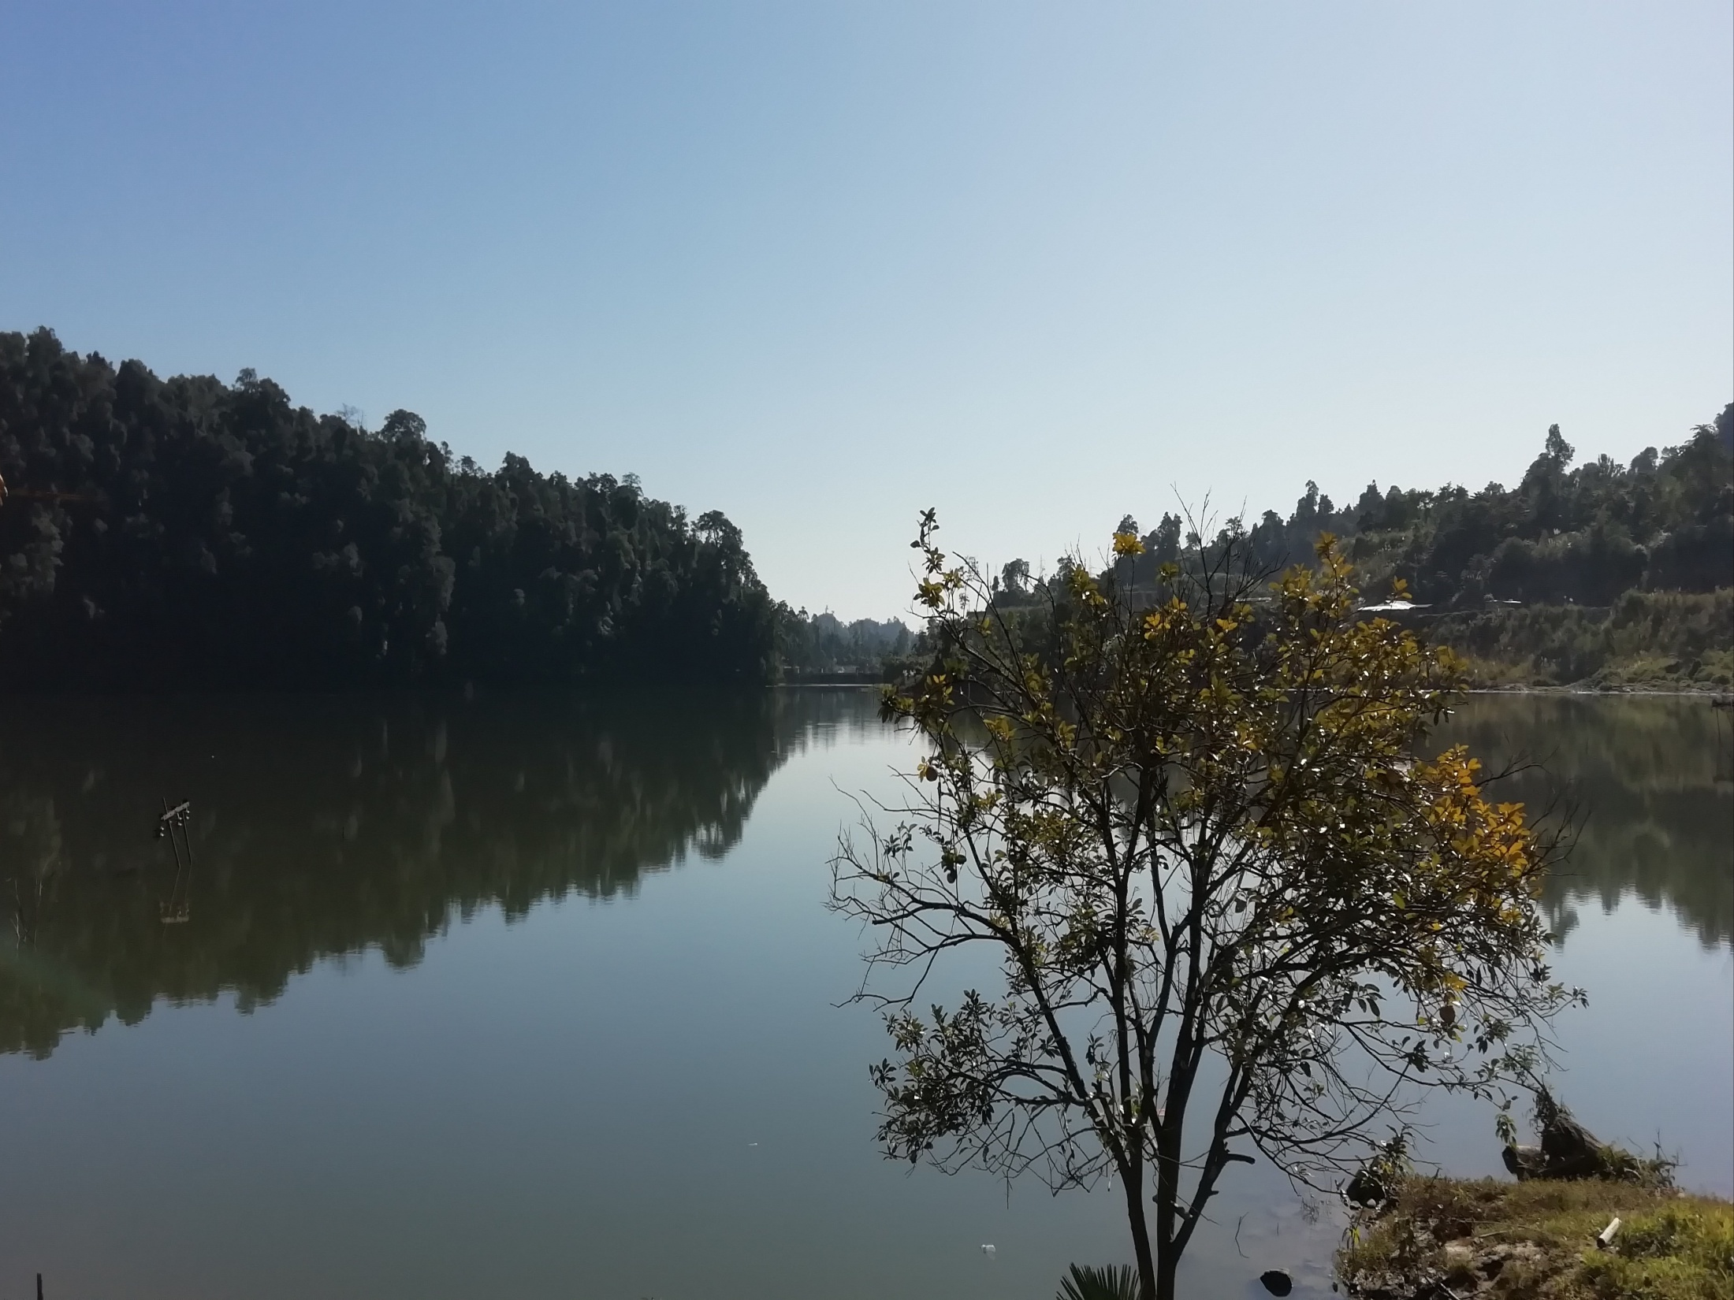
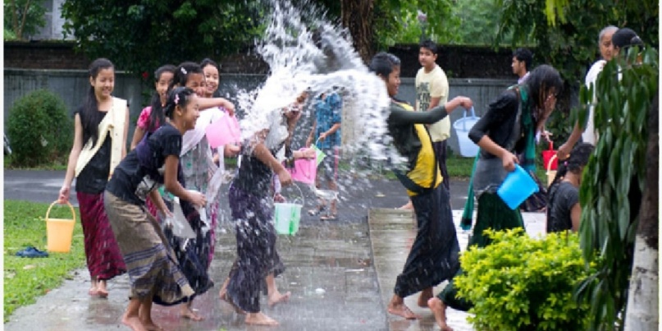
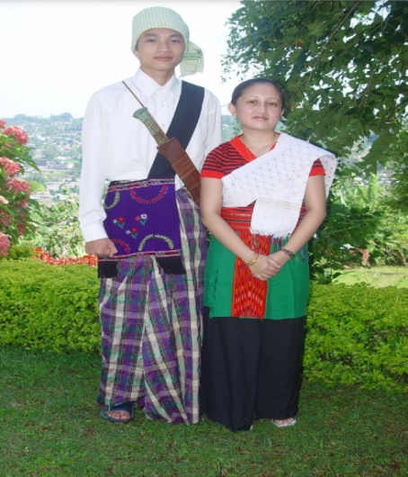
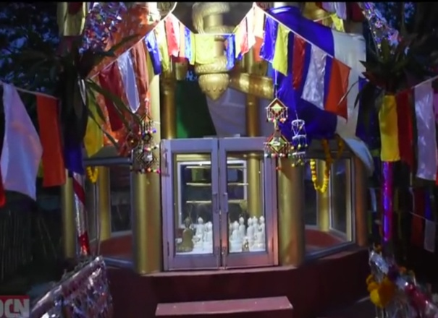
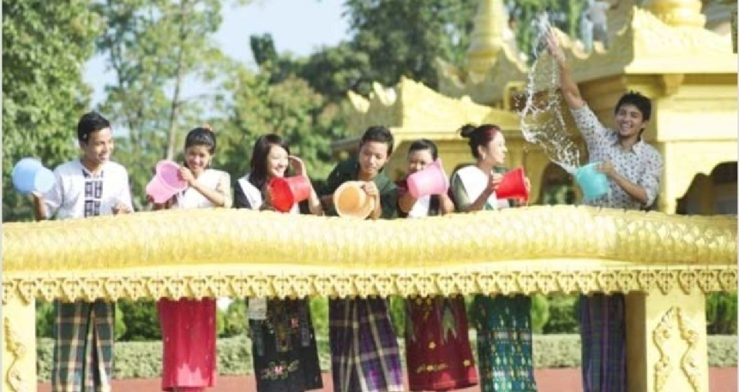
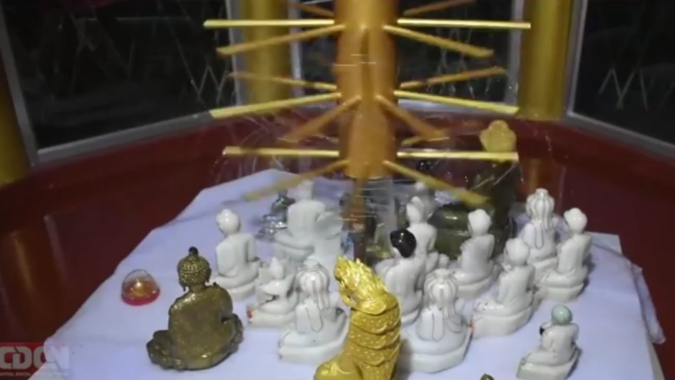
S a n g k e n
Sangken festival
celebration
Khampti
Men & Women
Kyongfra,
shrine for keeping idols
of lord Buddha
Devotees filling scented water
in water fountain ‘LUNGKONG’
Holy bath of lord Buddha

Slide 10
Water poured at
idol of lord
Buddha to seek
protection from
evil
Idols of lord Buddha
kept back at original
place
Procession after holy
bath of idols of lord
Buddha
Community feast ‘POI SANGKEN’

Slide 11
L o s a r
Losar celebration
Gifts & offerings
for deities
Monpa men & women
Feasting with families
friends
Monks doing ritualistic prayer

Slide 12
Families making KAPSE
KAPSE,
fried sweet dish
of Monpa tribe
Artist from Bhutan
Famous mask dance performed in Losar

Slide 13
M o p i n
Galo women in finest white dresses
Galo men & women
Preparation of
apong
(rice beer)
Women welcoming
guest by applying
ETTE
Ette ( rice flour) applied
on face as a mark of
social unity ,love

Slide 14
Food cooked in bamboo tube
Traditional Galo cuisine
AMIN
Mithun
Sacrificial
ceremony
Women carrying
the blood from
the sacrifice back
to the village
Galo POPIR dance

Slide 15
S i – d o n y i
Si – Donyi celebration
Tagin Men & Women
SEHTU (platform for rituals)
Traditional
Dance
NIBU ( local priest)
chanting UI( prayer)

Slide 16
Men performing
HOYI PENAM Dance
Tagin women
with ETTE smeared
on face
Mithun sacrifice , marking end of Si – Donyi festival

Slide 17
Shapawng Yawng ManauPoi
KACHIN festival in Myanmar
Singpho Men & Women
Men & Women in their colorful attire celebrating MANAU POI

Slide 18
C h a l o – L o k u
Nocte Jhum cultivation
Nocte Men in traditional
attire
Traditional song
Local dance on
CHAMKATJA day
Local priest performing
prayers
Men performing rituals

Slide 19
Nocte chief’s house
where final day of festival
is celebrated
Nocte cuisine
Dance by men & women before bidding farewell

Slide 20
O r i a h
Wancho jhum cultivation practices
Wancho Men & Women
PATKAI hills
Villagers exchange bamboo tube of rice beer
as a greetings and goodwill

Slide 21
Local dance by Wancho Men & women
Men performing in front
of ‘Zangvaan’
(sacred bamboo post)
Earlier inter village feuds

Slide 22
Boori boot festival
Reh festival
Ledum festival
Orange festival
Papum poma festival
Ziro music festival
Pangsupass International
winter festival
Tawang festival
Yomgo river festival

Slide 23
Dree festival football
tournament
Pageantary ,Boori boot
festival
Pageantary
Arunachal music festival
Sunidhi Chauhan at
Arunachal music festival
Fashion Show
Sonu Nigam at YUMGO
river festival
Raja Kumari at yumgo
river festival
Monali Thakur at
Solung festival

Slide 24
T h a n k y o u

