Slide 1
The Ek Bharat Shrestha Bharat programme, aims to actively enhance interaction between people of diverse cultures living in different States and UTs in India, with the objective of promoting greater mutual understanding amongst them.
ARUNACHAL PRADESH

Slide 2
ARUNACHAL PRADESH
Various Tribal Group ( with Different Tradition and Cultures).
Potential Biological Hotspot.
Potential Tourism.
Potential Hydro Electric Power.

Slide 3
GALO
Race:- Mongoloid
Galo dialect-Tibeto-Burmese language group
GALOs are the decedents of TANI
SOCIAL SYSTEM of GALO
NAMING SYSTEM IN GALO

Slide 4
TANI AS PER GALO MYTH THE FIRST MAN ON EARTH
There was nothing except Cloud and Fog
Sky (Medo) and Earth ( Hichi)
Jimi ( Creator Mother) “ The literary meaning of JIMI is absolute silence”
Then Rini ( Abo TANI) and TAKI
M

Slide 5
Galo Village and House
Galo society is an agrarian society. All the members of the Family use to work in agricultural field.
This farmers then divided into following category
Nyigam ( Hunter)
Nyiga ( Warrior)
Nyibo ( Priest)
Nyikok (Orators)
Slavery System was prevailing in olden days
Galo Society is patriarchal.
Galo Society polygamy is allowed
Child marriage(Neppe Nyida) System was prevailing in olden Days.
Right to inheritance the immovable property belongs to the male member and movable to the female.
1
2
M

Slide 6
2

Slide 7
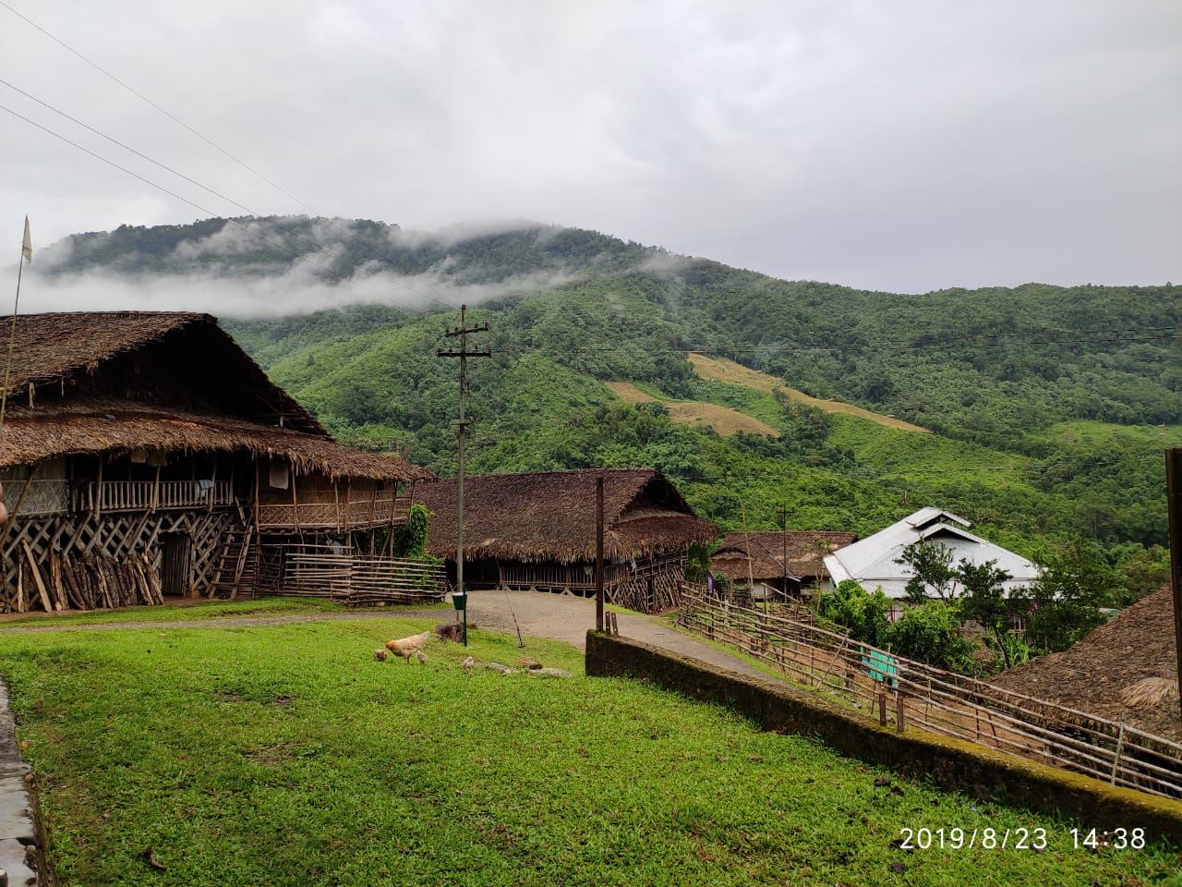
2

Slide 8
GALO TRIBE FOLLOWS GENEALOGY SYSTEM
TANI
NICHI
CHIDE
DEMEN
MENRA
REBA
BAM
MEKAR
KARME
MECHI
CHIDO
DOPO
PONI
NIRO
ROHAR
HARNI
NIM
MARI
RIME
MAGO
GOLI
LIME
MAGO
GOLI
LIGO
GOYI
YIGO
GOMAR
TA + NI
NI + CHI
CHI + DE
DE + MEN
MEN + RA
RE + BA
BA + M
ME + KAR
KAR + ME
ME + CHI
CHI + DO
DO + PO
PO + NI
NI + RO
RO + HAR
HAR + NI
NI + M
MA + RI
RI + ME
MA + GO
GO + LI
LI + ME
MA + GO
GO + LI
LI + GO
GO + YI
YI + GO
GO + MAR

Slide 9
THANK YOU

